Slide 1
The flawed
and the flawless
(Judges Ch 10-11)

Slide 2
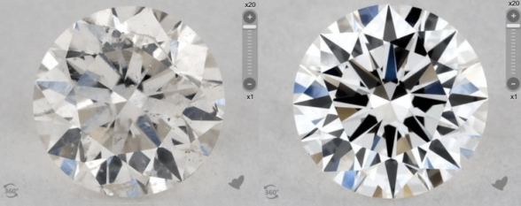
The flawed and the flawless
(Judges Ch 10-11)
Jephthah (the flawed)
A difficult beginning – (11:1-11)

Slide 3
The flawed and the flawless
(Judges Ch 10-11)
Jephthah (the flawed)
A difficult beginning – (11:1-11)
A useful middle – (11:12-29)

Slide 4
The flawed and the flawless
(Judges Ch 10-11)
Jephthah (the flawed)
A difficult beginning – (11:1-11)
A useful middle – (11:12-29)
A terrible end – (11:30-40)

Slide 5
The flawed and the flawless
(Judges Ch 10-11)
Jesus (the flawless)
‘‘He committed no sin, and no deceit was found in his mouth’.
When they hurled their insults at him he did not retaliate; when he suffered, he made no threats. Instead he entrusted himself to him who judges justly. He himself bore our sins in his body on the tree, so that we might die to sins and live for righteousness; by his wounds we are healed.
For you were like sheep going astray, but now you have returned to the Shepherd and Overseer of your souls.’
(1 Peter 2:22-25)

Slide 6
The flawed and the flawless
(Judges Ch 10-11)
Jesus the Flawless had:
A difficult beginning – ‘his own received him not,’
A (most ) useful middle – ‘accredited.... by miracles, wonders and signs.’
A terrible end – ‘put him to death by nailing him on a cross’.

