Slide 1
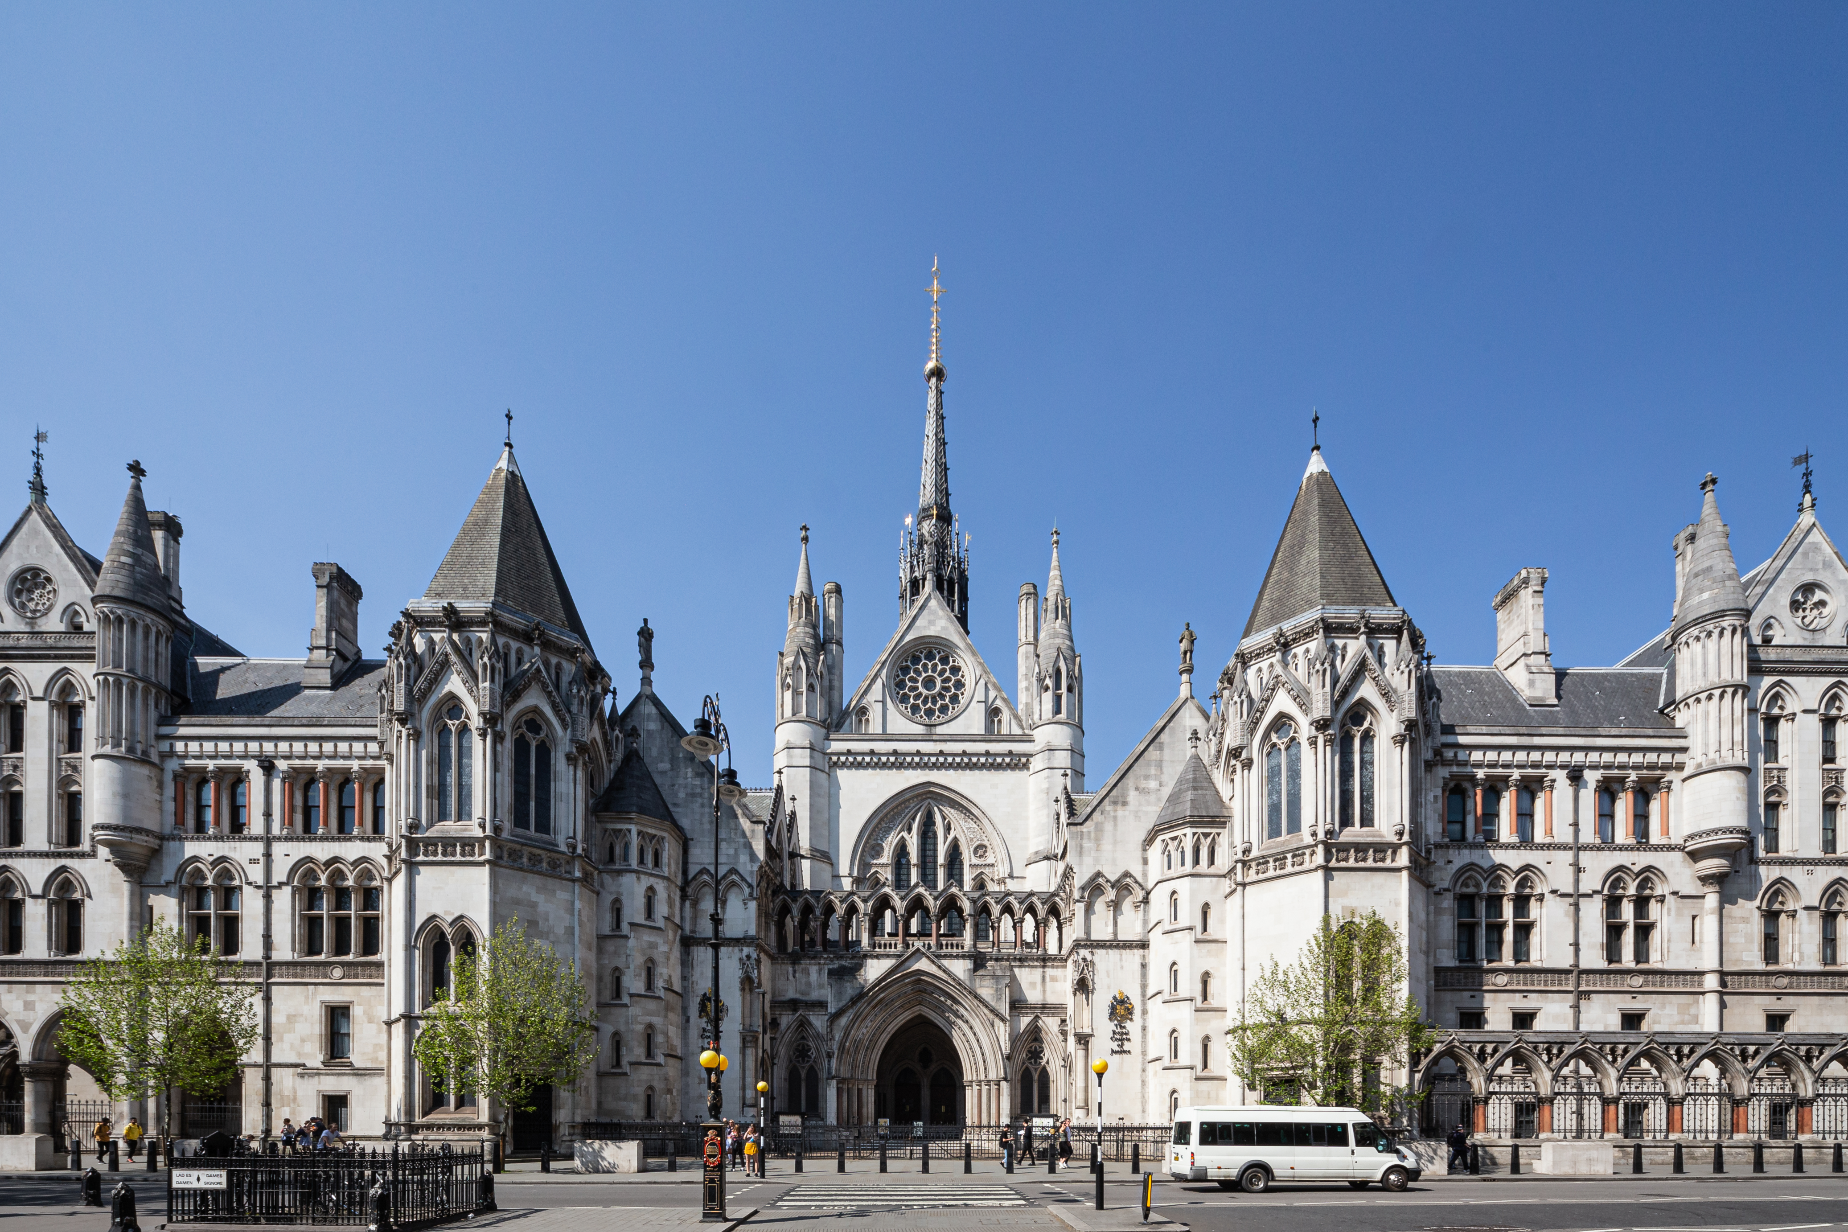

Slide 2
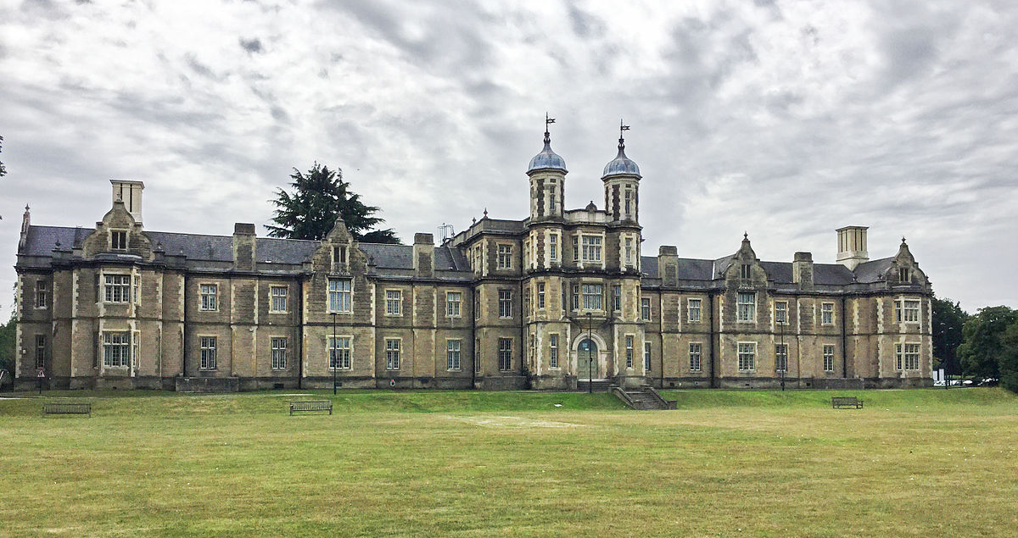

Slide 3
The 4 stages of a typical trial
charge
examination
verdict
sentence

Slide 4
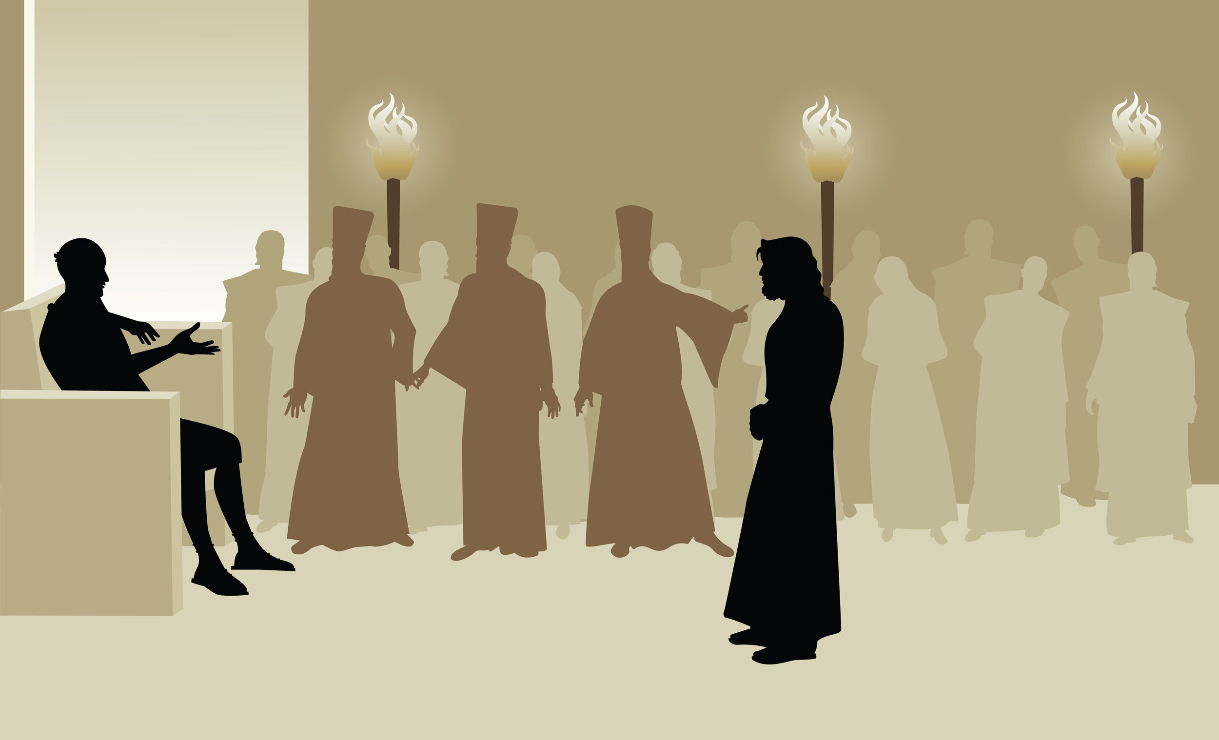
Jesus' trial before Pilate

Slide 5
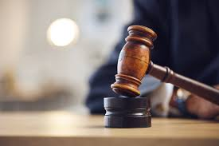
Jesus was judged

Slide 6
Jesus was judged
1. Charge
confusing everyone
commanding people not to pay tax
calling himself king

Slide 7
Jesus was judged
2. Examination
nothing to find!

Slide 8
Jesus was judged
3. Verdict
v4 - “I find no basis for a charge against this man.”
Jesus is innocent!

Slide 9
Jesus was judged
4. Sentence
v16 - “I will punish him and then release him.”

Slide 10
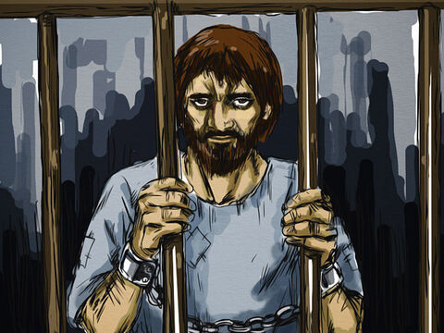
Barabbas

Slide 11
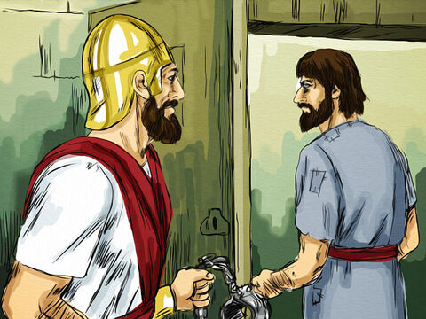
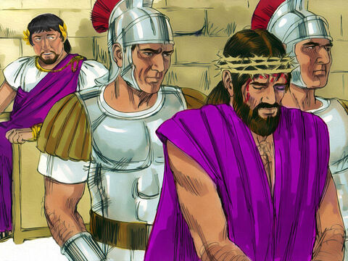
Barabbas
Jesus

Slide 12
Jesus was judged
...but Jesus was innocent

Slide 13
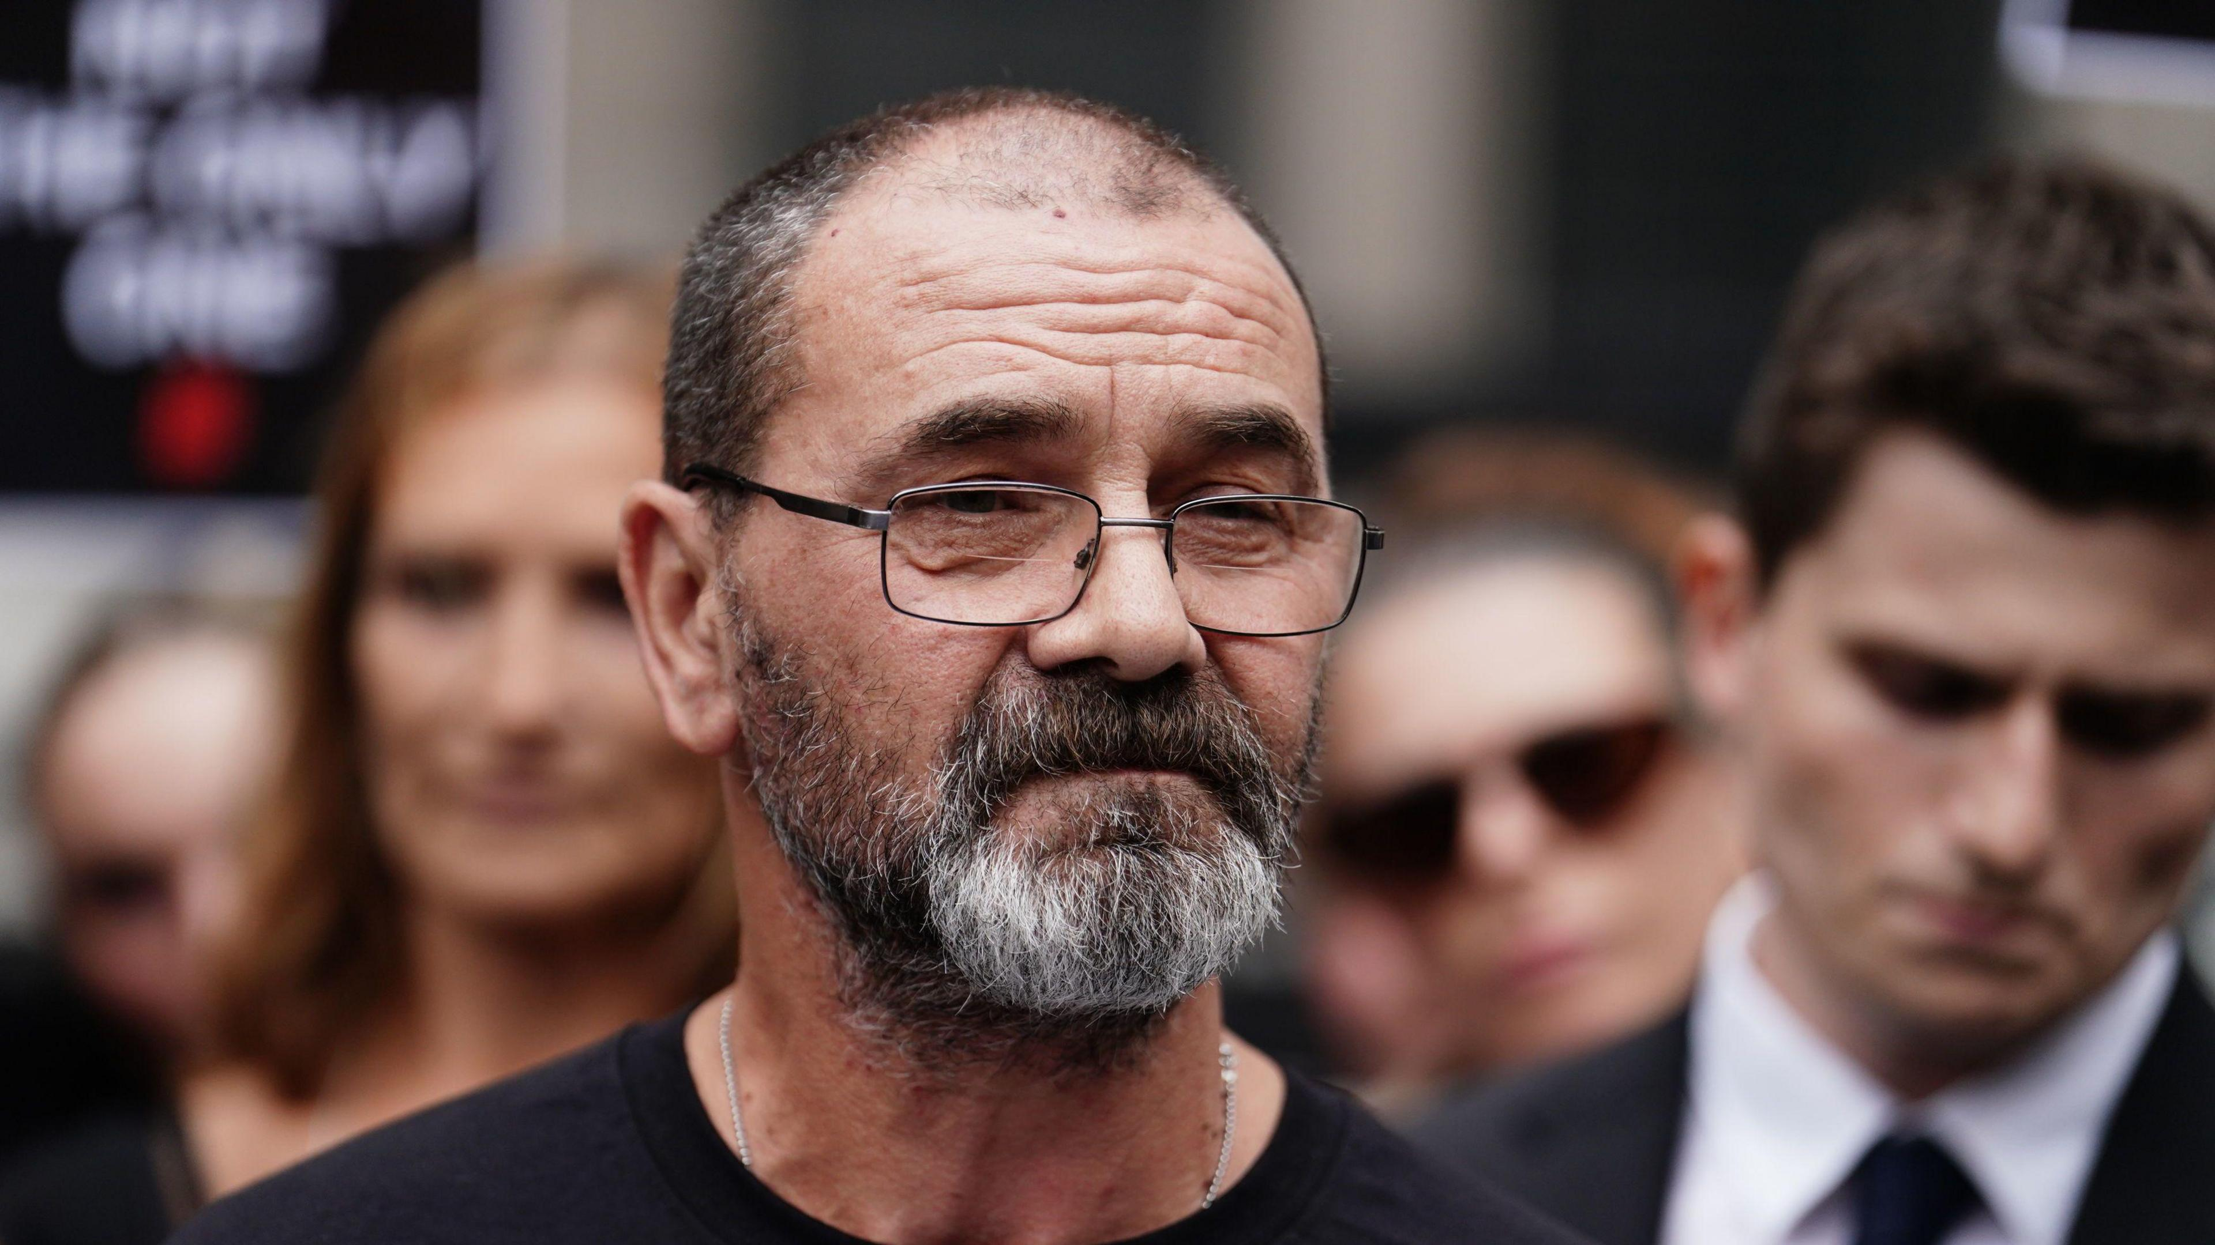

Slide 14
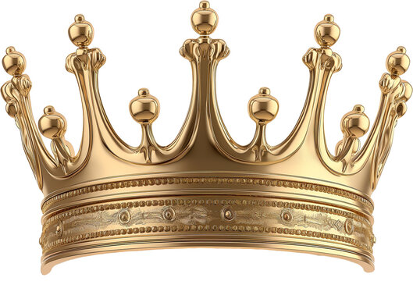
Jesus will be the judge

Slide 15
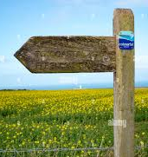
“If you are the Messiah, tell us”
- v67
"Are you then the Son of God?"
- v70
"Are you the king of the Jews?"
- v3

Slide 16
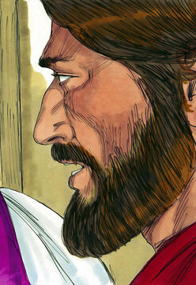
“If you are the Messiah, tell us”
Jesus answered, “If I tell you, you will not believe me, and if I asked you, you would not answer.
But from now on, the Son of Man will be seated at the right hand of the mighty God.”

Slide 17
Psalm 110
1 The Lord says to my lord:
“Sit at my right hand until I make your enemies a footstool for your feet.”

Slide 18
Daniel 7
13 ‘In my vision at night I looked, and there before me was one like a son of man, coming with the clouds of heaven. He approached the Ancient of Days and was led into his presence. 14 He was given authority, glory and sovereign power; all nations and peoples of every language worshipped him.'

Slide 19
Jesus will be the judge

Slide 20
everyone else on trial

Slide 22
all of us on trial

Slide 23
Barabbas

