Slide 1
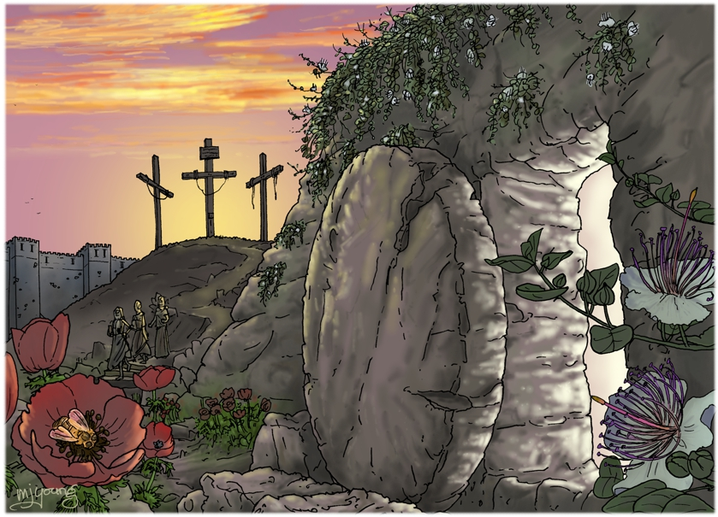

Slide 2
We were under great pressure, far beyond our ability to endure, so that we despaired of life itself. Indeed, we felt we had received the sentence of death. But this happened that we might not rely on ourselves but on God, who raises the dead.
2 Corinthians 1:8-9

Slide 3
Disaster!
So that we might not rely on ourselves

Slide 4
Rely on God, who raises the dead

Slide 5
Iranian Revolution
1977
Cultural revolution in China 1966

Slide 6
A divine pattern?
Jesus:
“My soul is overwhelmed with sorrow to the point of death.”

Slide 7
Pray!
Don’t give up!
Therefore, my dear brothers and sisters, stand firm. Let nothing move you. Always give yourselves fully to the work of the Lord, because you know that your labour in the Lord is not in vain.

