Slide 1
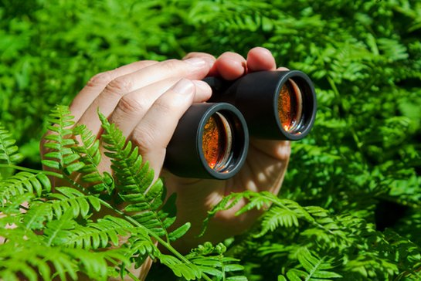
discovery

Slide 2
discovery or invention?

Slide 3
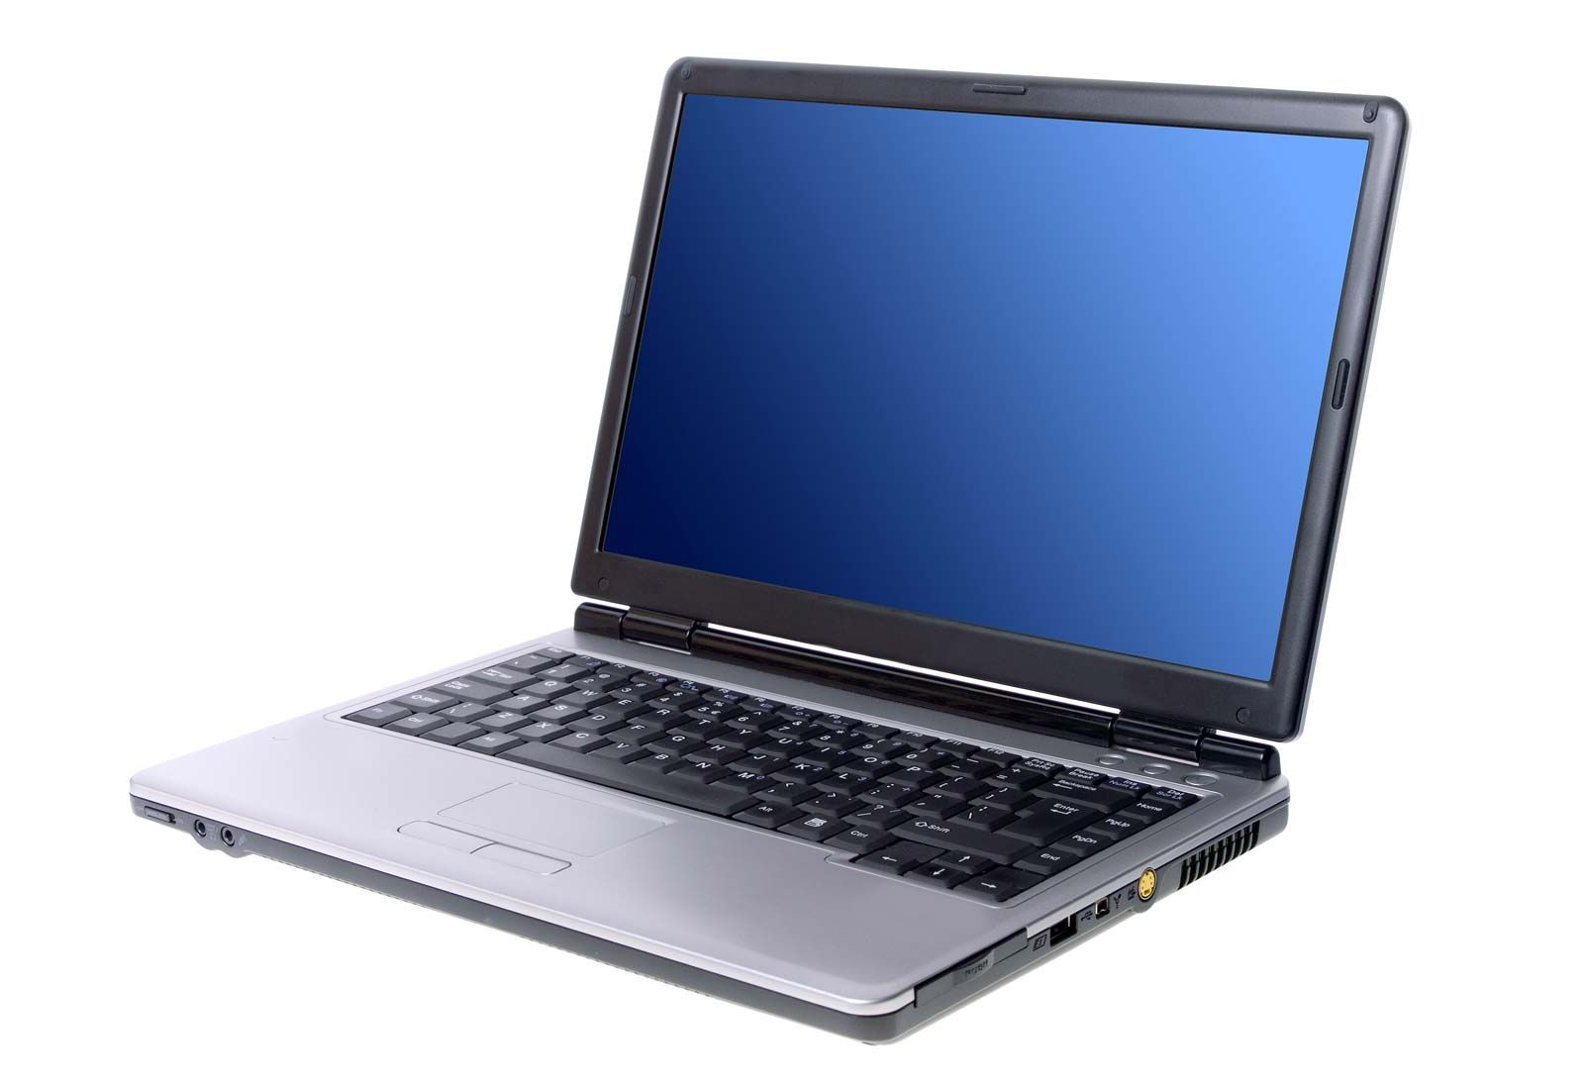
discovery or invention?

Slide 4
discovery or invention?

Slide 5
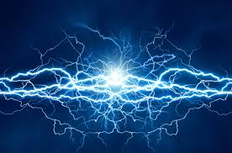
discovery or invention?

Slide 6
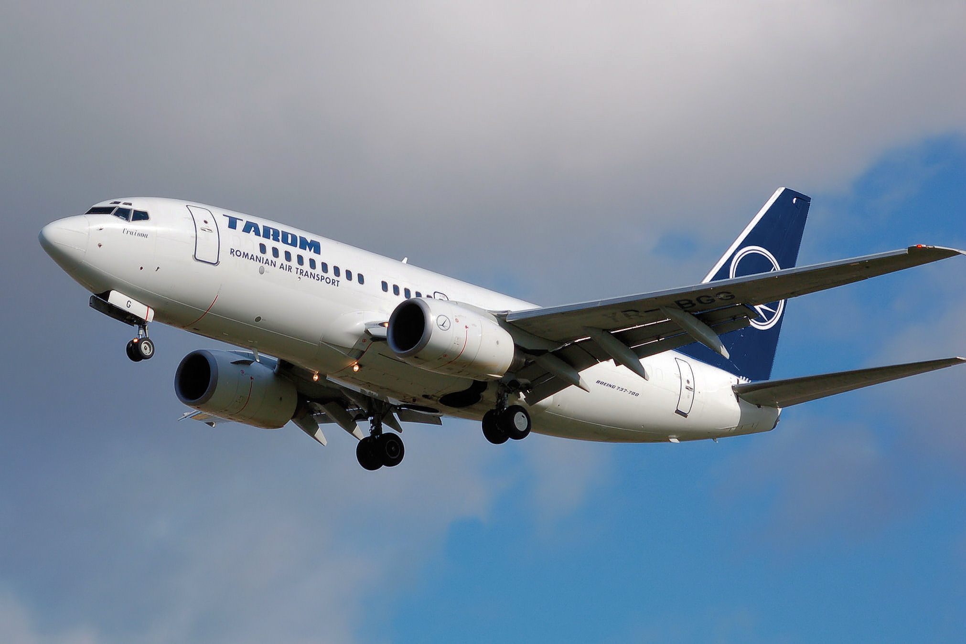
discovery or invention?

Slide 7
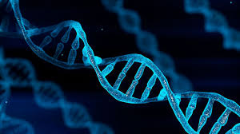
discovery or invention?

Slide 8
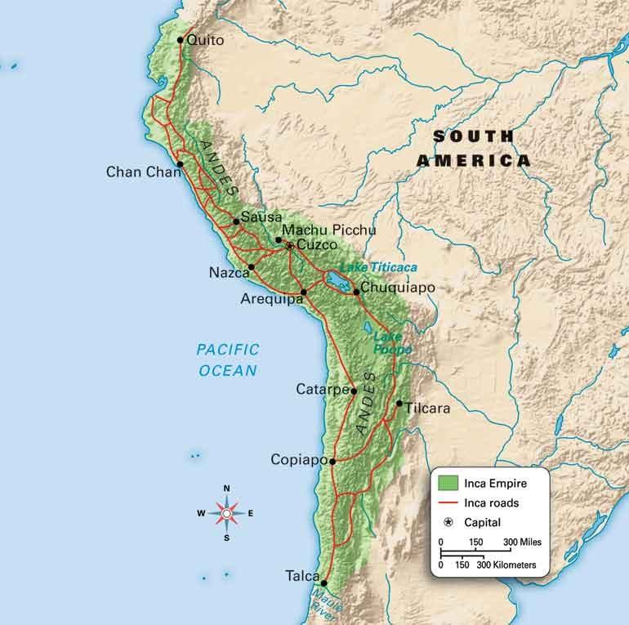
the Inca civilisation

Slide 9
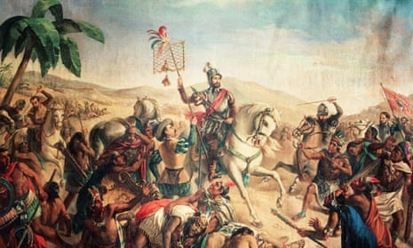
Spanish conquistadores

Slide 10
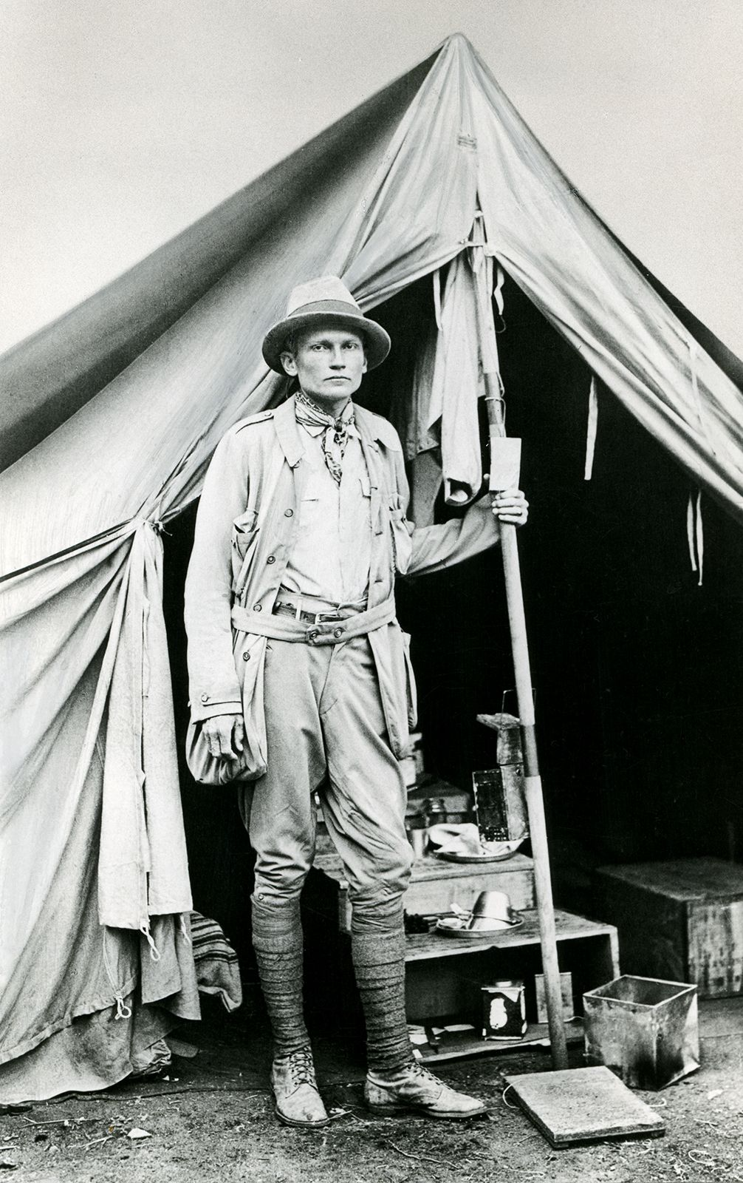
Hiram Bingham

Slide 11
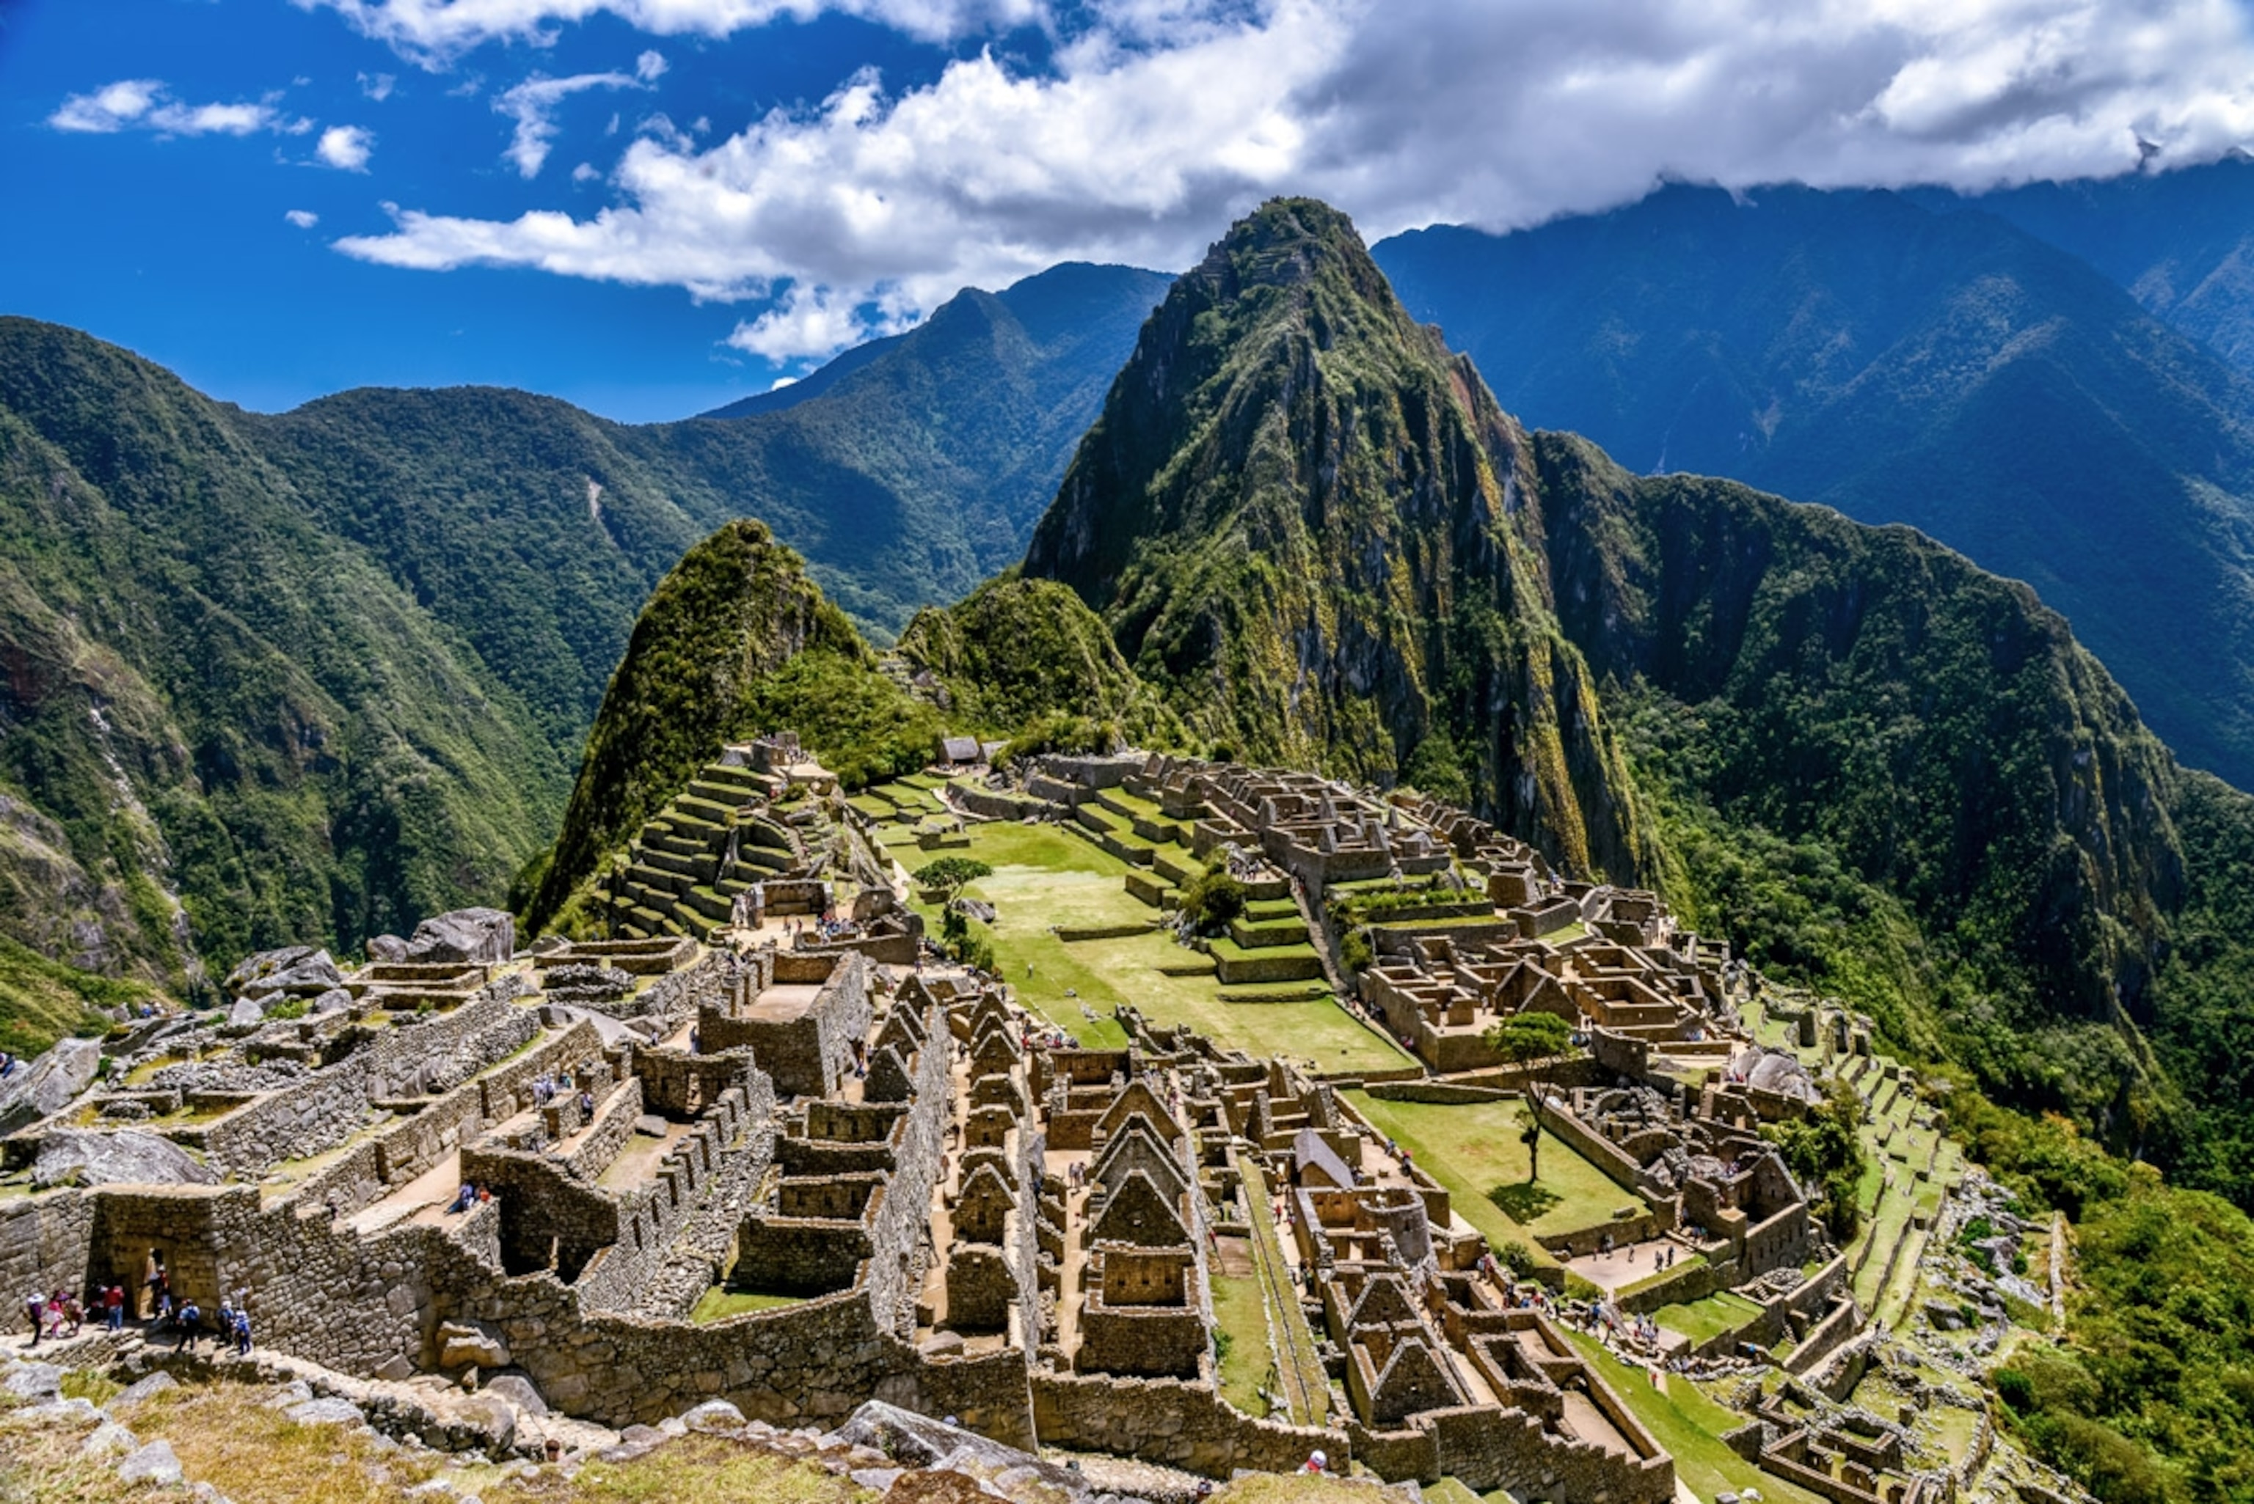
Machu Picchu

Slide 12
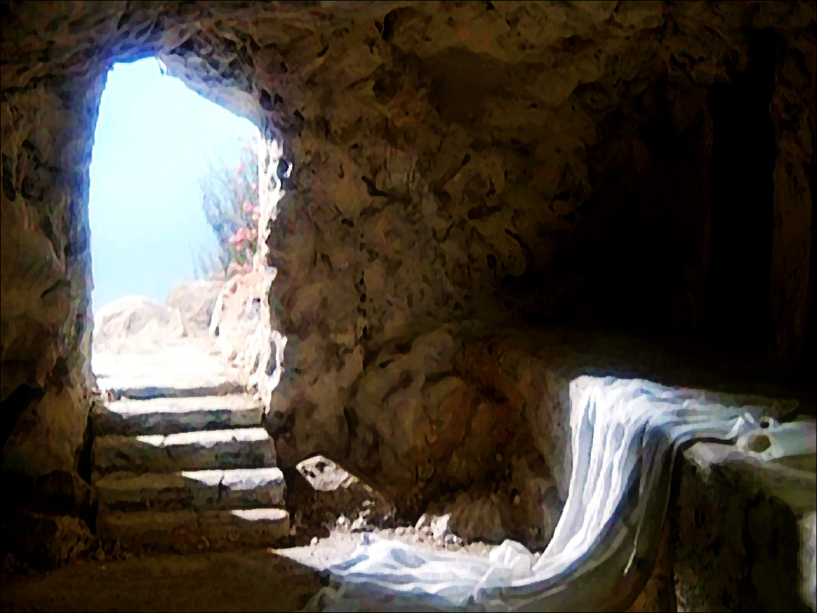
discovery or invention?

Slide 15
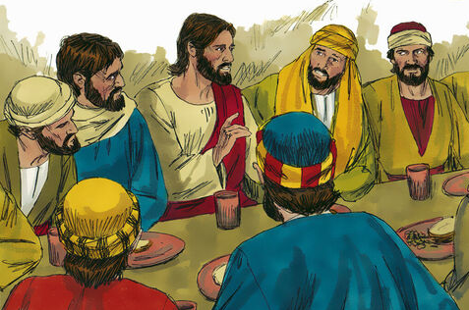
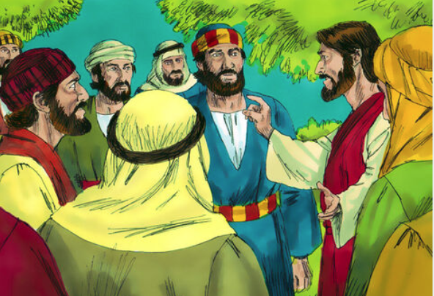
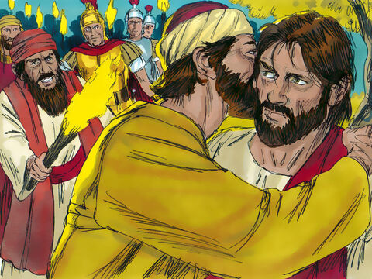
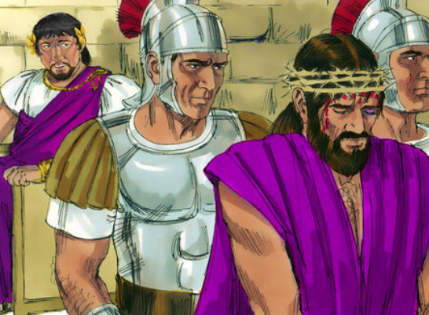
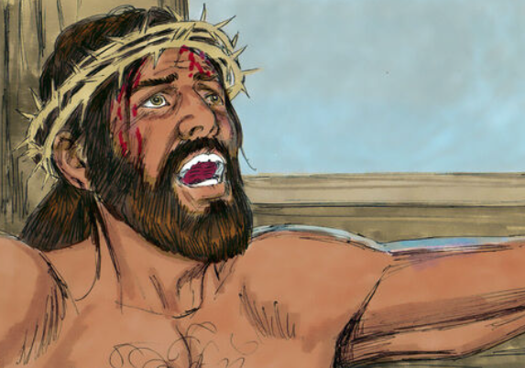
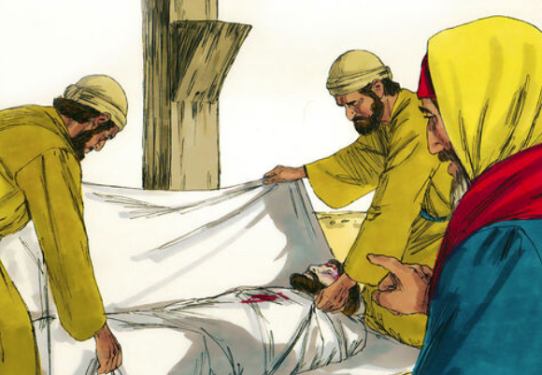

Slide 16
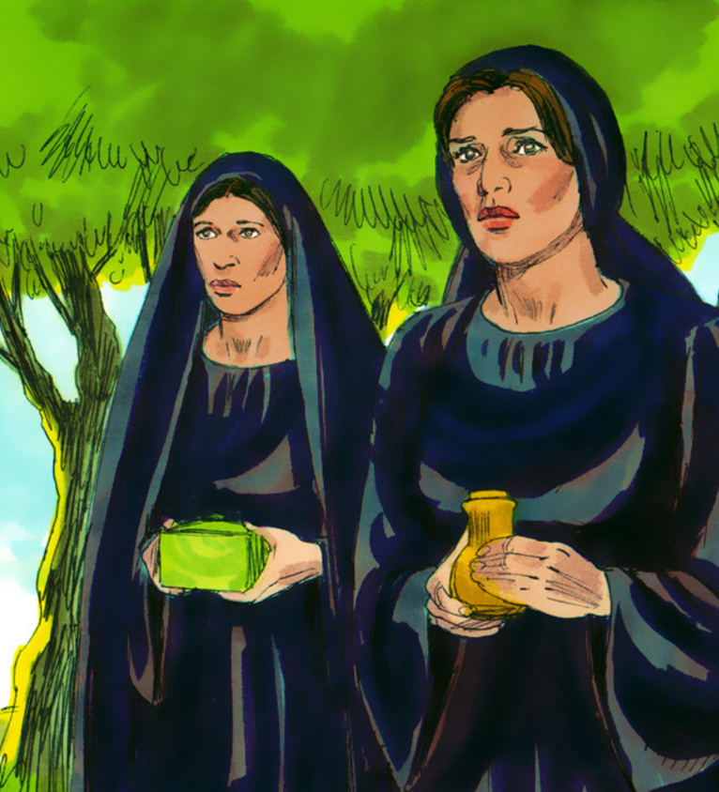
The women's great discovery (v1-8)

Slide 17
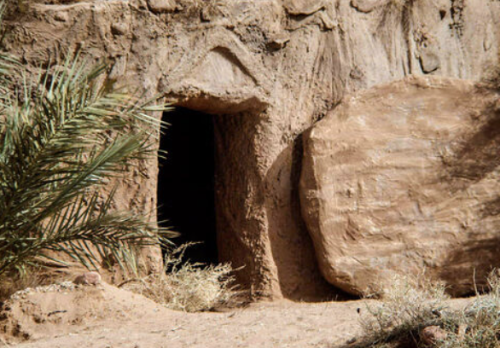
Shock 1: the stone ...was moved (v2)

Slide 18
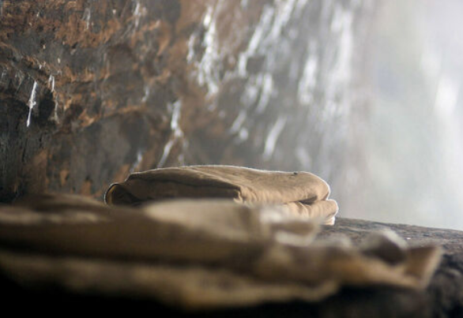
Shock 2: Jesus' body ...was gone (v3)

Slide 19
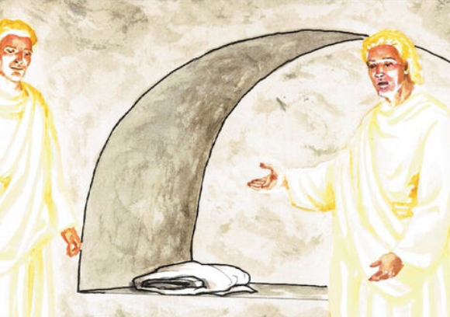
Shock 3: two angels ...were there (v4)

Slide 20
The resurrection accounts:
are based on eyewitness reports

Slide 21
The resurrection accounts:
are based on eyewitness reports
do fit together

Slide 22
The resurrection accounts:
are based on eyewitness reports
do fit together
are God's word

Slide 23
Shock 4: dead Jesus ...was alive (v5-7)

Slide 24
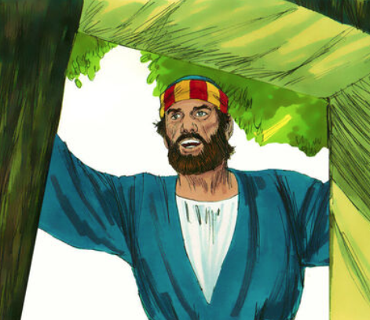
2. The disciples' great discovery (v9-12)

