Slide 1
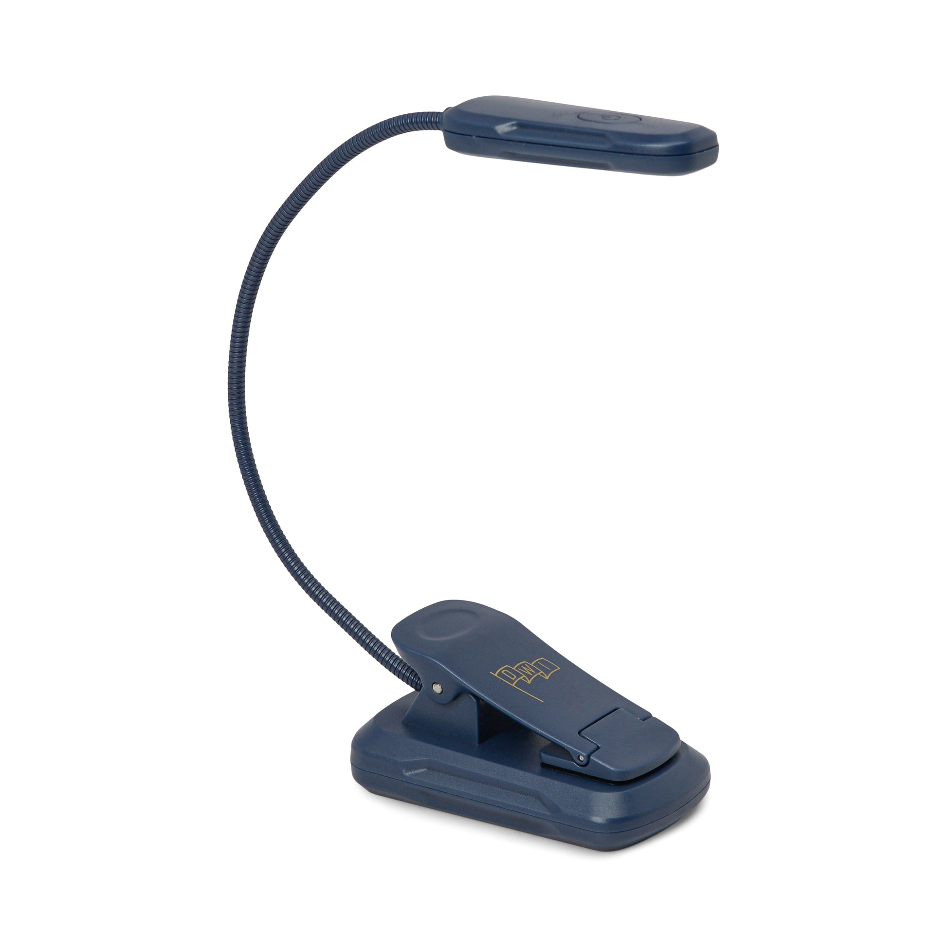

Slide 3
= setting something free by paying a price for it

Slide 4
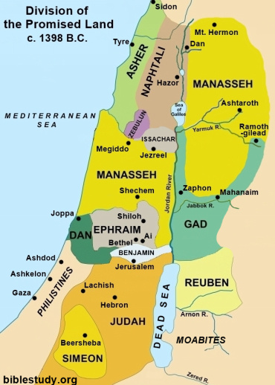

Slide 5
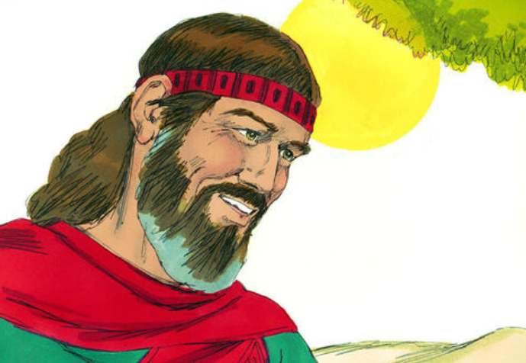

Slide 6
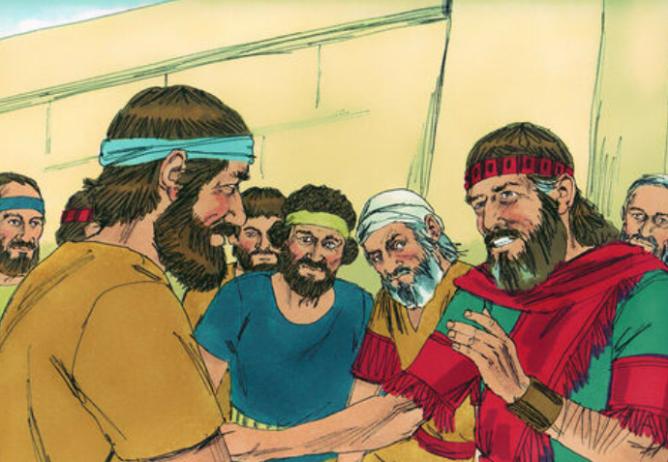

Slide 7
Praise God who gives...
A redeemer

Slide 8
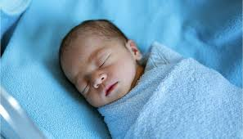
had a child

Slide 9
Praise God who gives...
A redeemer
A son

Slide 10
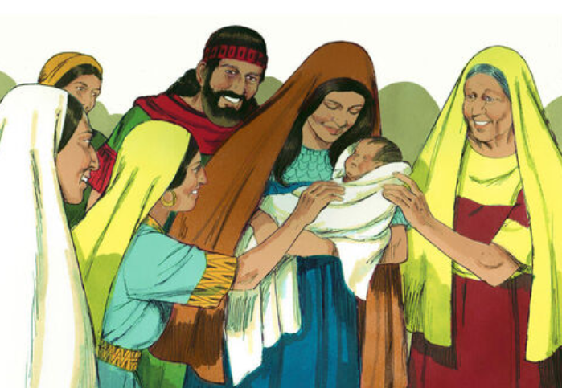

Slide 11
Ruth 4
11 Then the elders and all the people at the gate said, “We are witnesses. May the Lord make the woman who is coming into your home like Rachel and Leah, who together built up the family of Israel. May you have standing in Ephrathah and be famous in Bethlehem. 12 Through the offspring the Lord gives you by this young woman, may your family be like that of Perez, whom Tamar bore to Judah.”

Slide 12
Ruth 4
11 Then the elders and all the people at the gate said, “We are witnesses. May the Lord make the woman who is coming into your home like Rachel and Leah, who together built up the family of Israel. May you have standing in Ephrathah and be famous in Bethlehem. 12 Through the offspring the Lord gives you by this young woman, may your family be like that of Perez, whom Tamar bore to Judah.”
14 "May he become famous throughout Israel!"

Slide 13
Ruth 4
17 The women living there said, “Naomi has a son!” And they named him Obed. He was the father of Jesse, the father of David.

Slide 14
Praise God who gives...
A redeemer
A son
A king

Slide 15
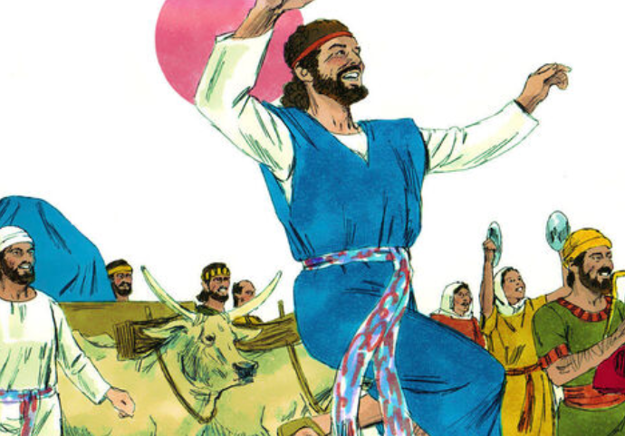
King David

Slide 16
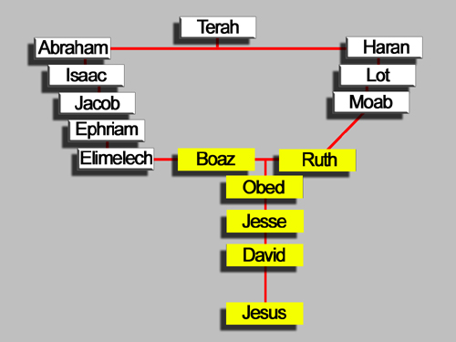

Slide 18
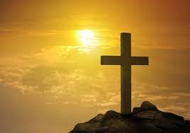
Praise God for Jesus who is...
a redeemer
his son
our king

