Slide 1
What kind of stories do you like?

Slide 2
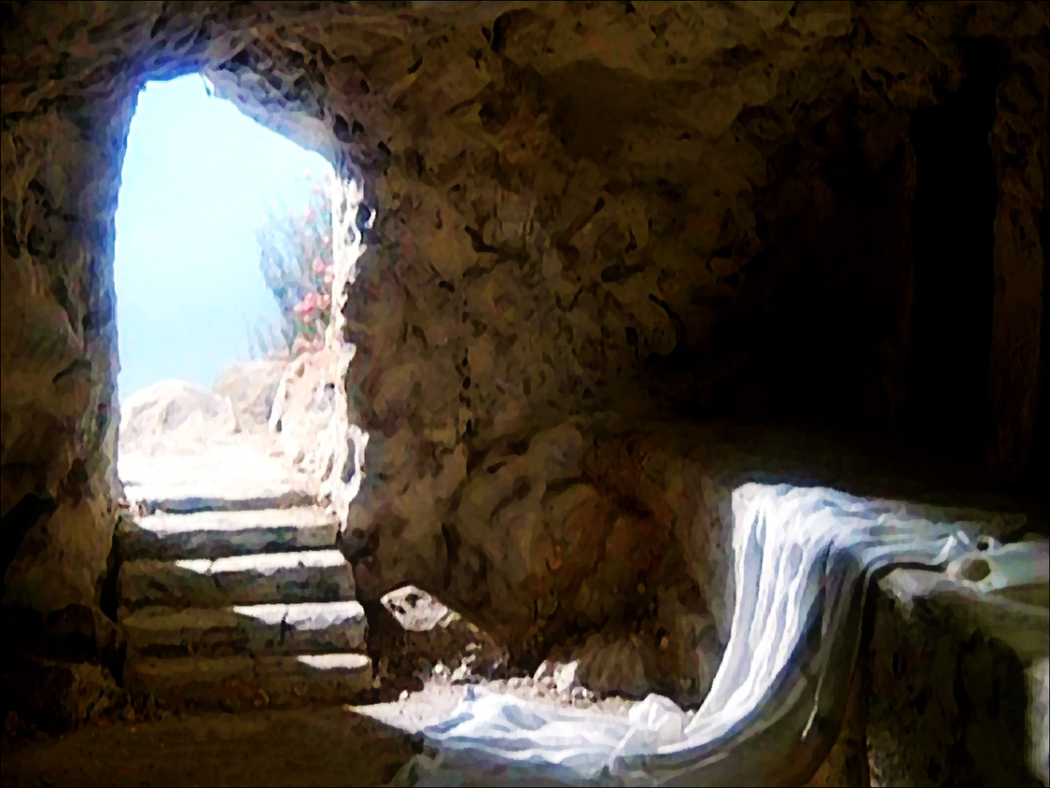
the empty tomb

Slide 3
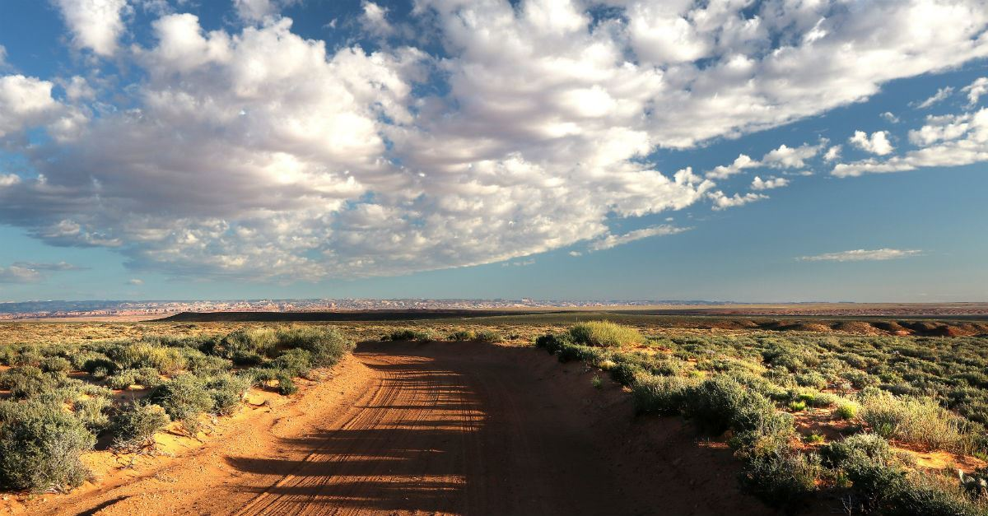
the road to Emmaus

Slide 4
Believe in Jesus ...who is alive (v36-43)

Slide 5
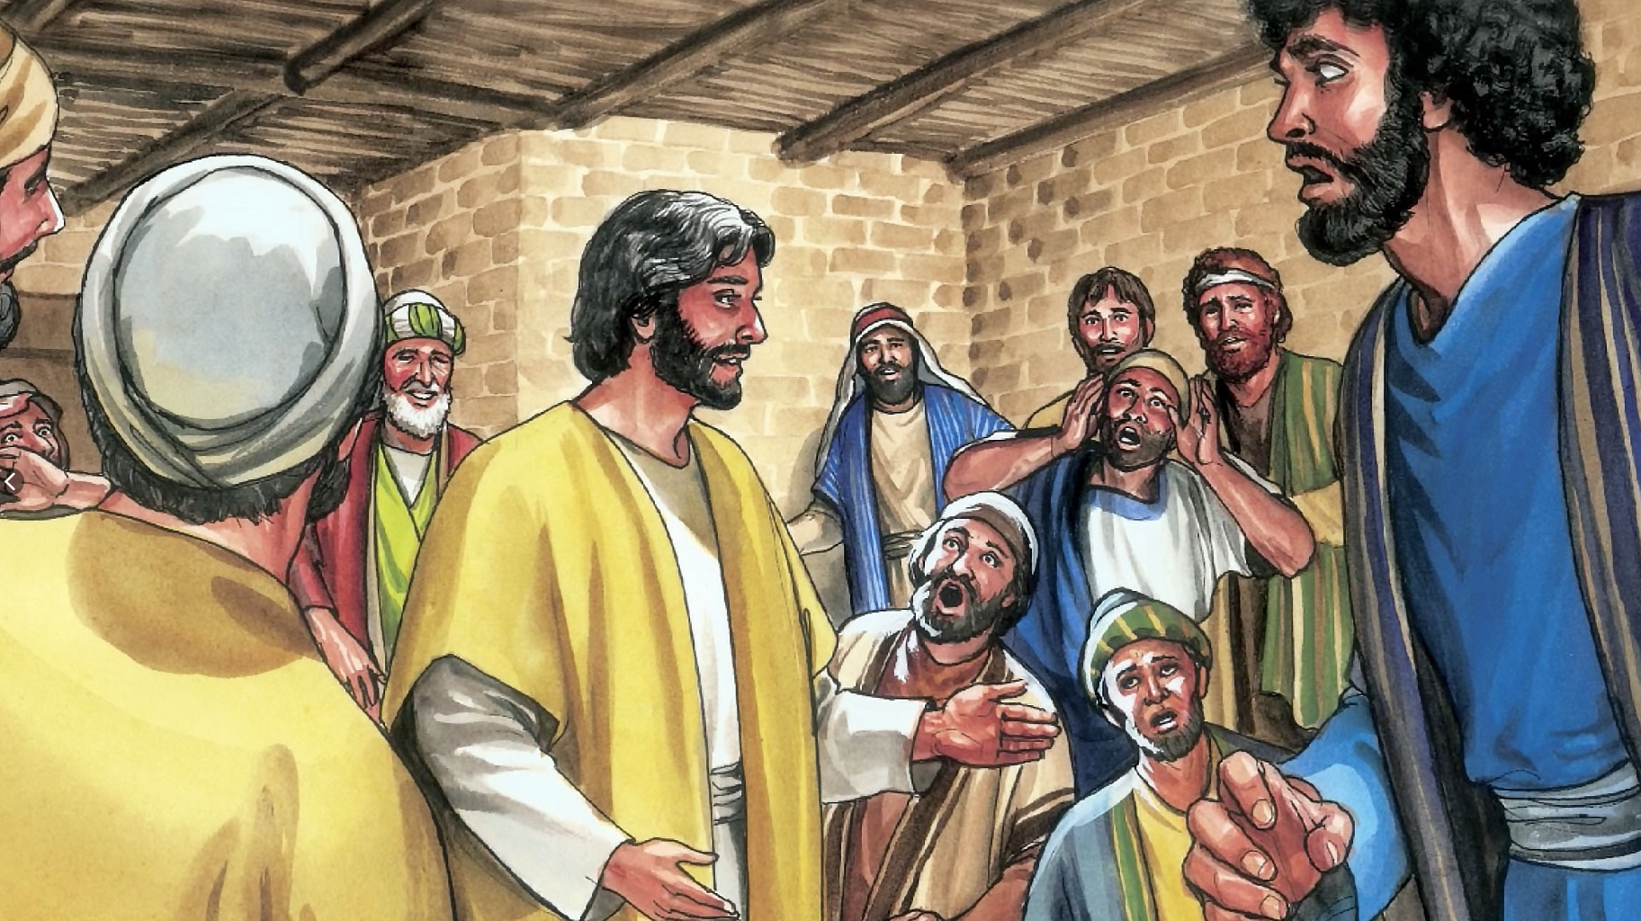
While they were still talking about this, Jesus himself stood among them (v36)

Slide 6
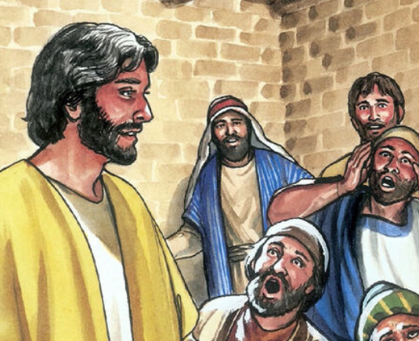
4 proofs that Jesus was alive
Sight
Sound
Touch
Eating

Slide 7
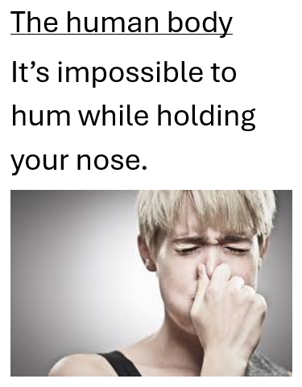

Slide 8
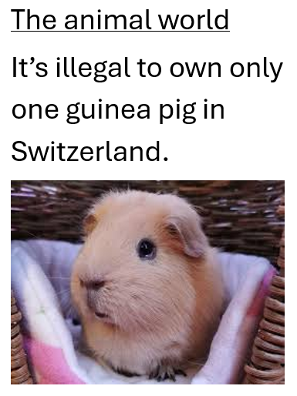

Slide 9
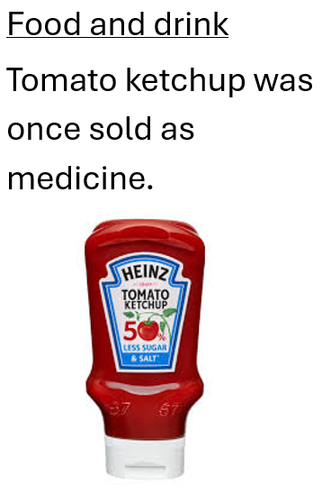

Slide 10
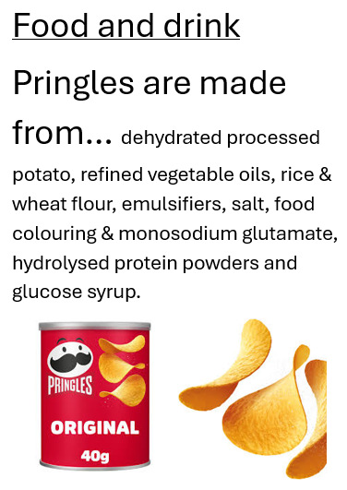

Slide 11
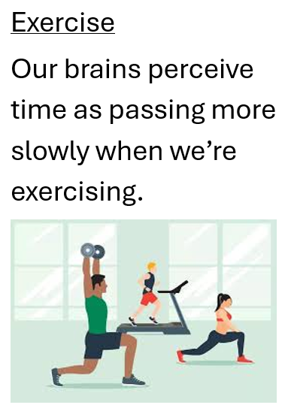

Slide 12
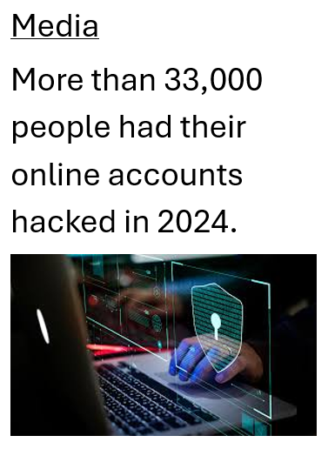

Slide 13
pointless facts

Slide 14
facts that make a difference
pointless facts
vs

Slide 15
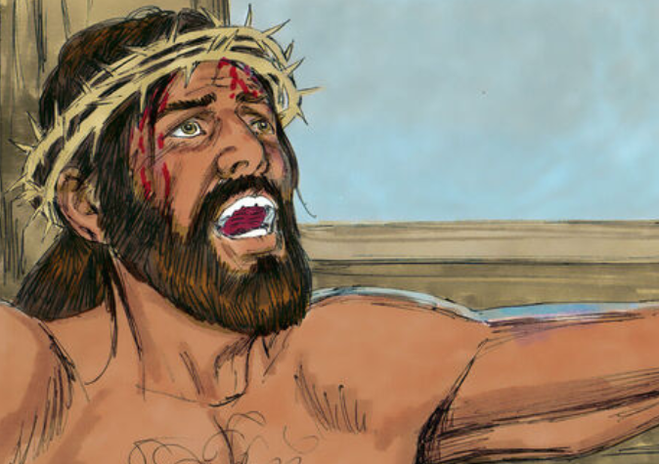
a fact that means something

Slide 16
2. Believe in Jesus ...who can forgive us (v44-53)

Slide 17
Luke 24
45 Then he opened their minds so they could understand the Scriptures. 46 He told them, “This is what is written: The Messiah will suffer and rise from the dead on the third day, 47 and repentance for the forgiveness of sins will be preached in his name to all nations, beginning at Jerusalem.

Slide 18
Luke 24
45 Then he opened their minds so they could understand the Scriptures. 46 He told them, “This is what is written: The Messiah will suffer and rise from the dead on the third day, 47 and repentance for the forgiveness of sins will be preached in his name to all nations, beginning at Jerusalem.

Slide 19
Why?
so our sins can be forgiven

Slide 21
our sins can be forgiven

Slide 22
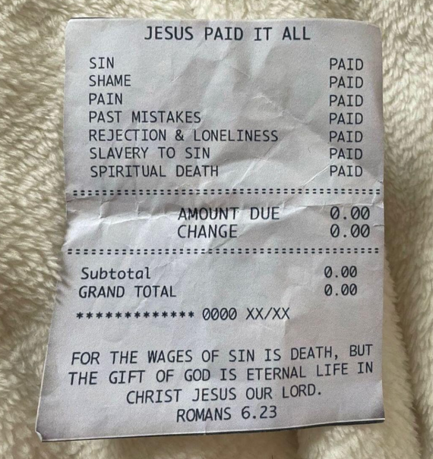

Slide 23
to be preached in his name to all nations

