Slide 2
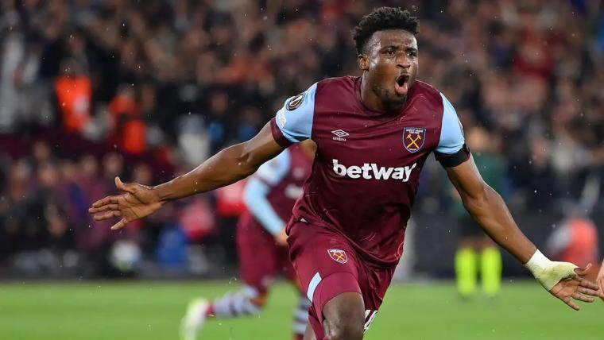

Slide 4
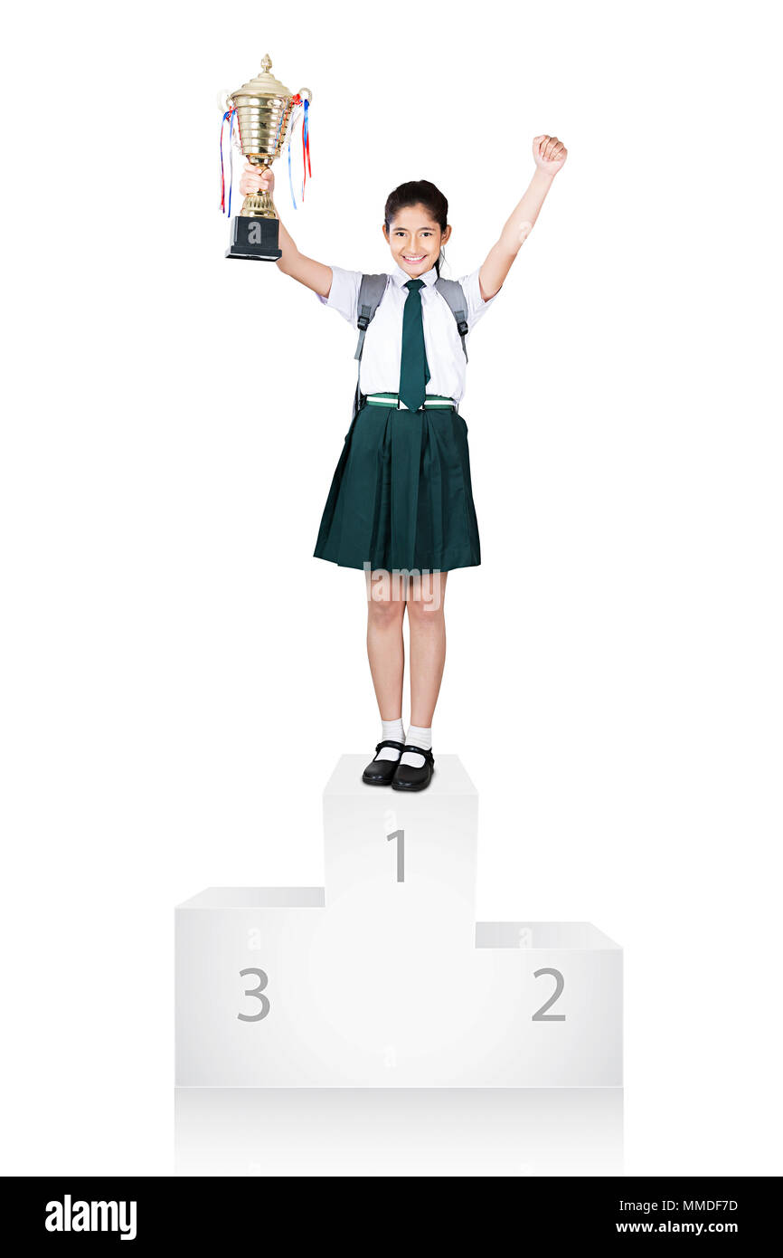

Slide 5
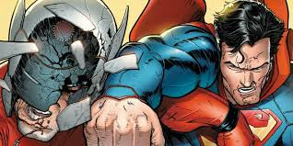

Slide 6
Cheer for God who wins

Slide 7
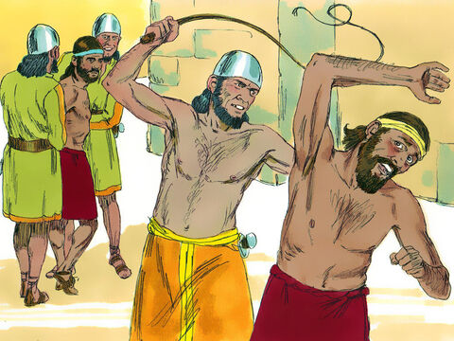
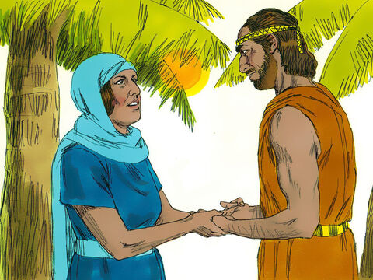
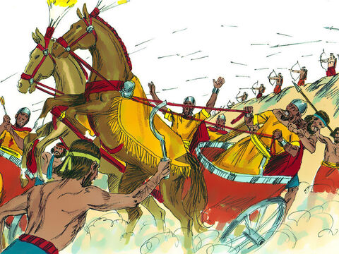
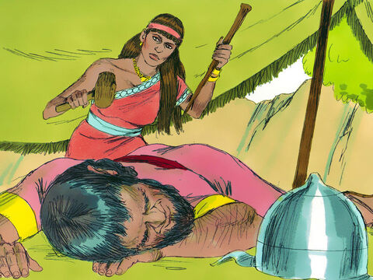
1
2
3
4

Slide 8
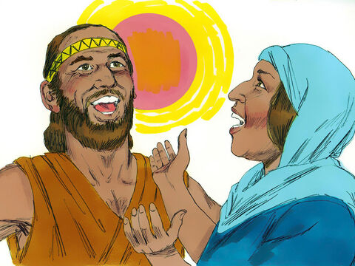
Praise the LORD!

Slide 9
Cheer for God
...because he wins!

Slide 10
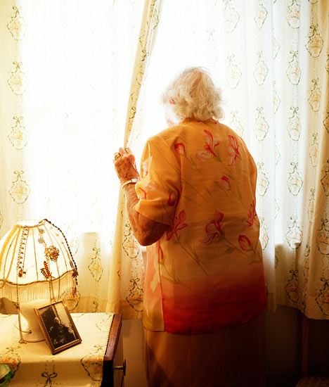
...but what about Sisera's mum?

Slide 11
Judges 5:28-30
‘Through the window peered Sisera’s mother; behind the lattice she cried out, “Why is his chariot so long in coming? Why is the clatter of his chariots delayed?” 29 The wisest of her ladies answer her; indeed, she keeps saying to herself, 30 “Are they not finding and dividing the spoils: a woman or two for each man, colourful garments as plunder for Sisera, colourful garments embroidered, highly embroidered garments for my neck – all this as plunder?”

Slide 12
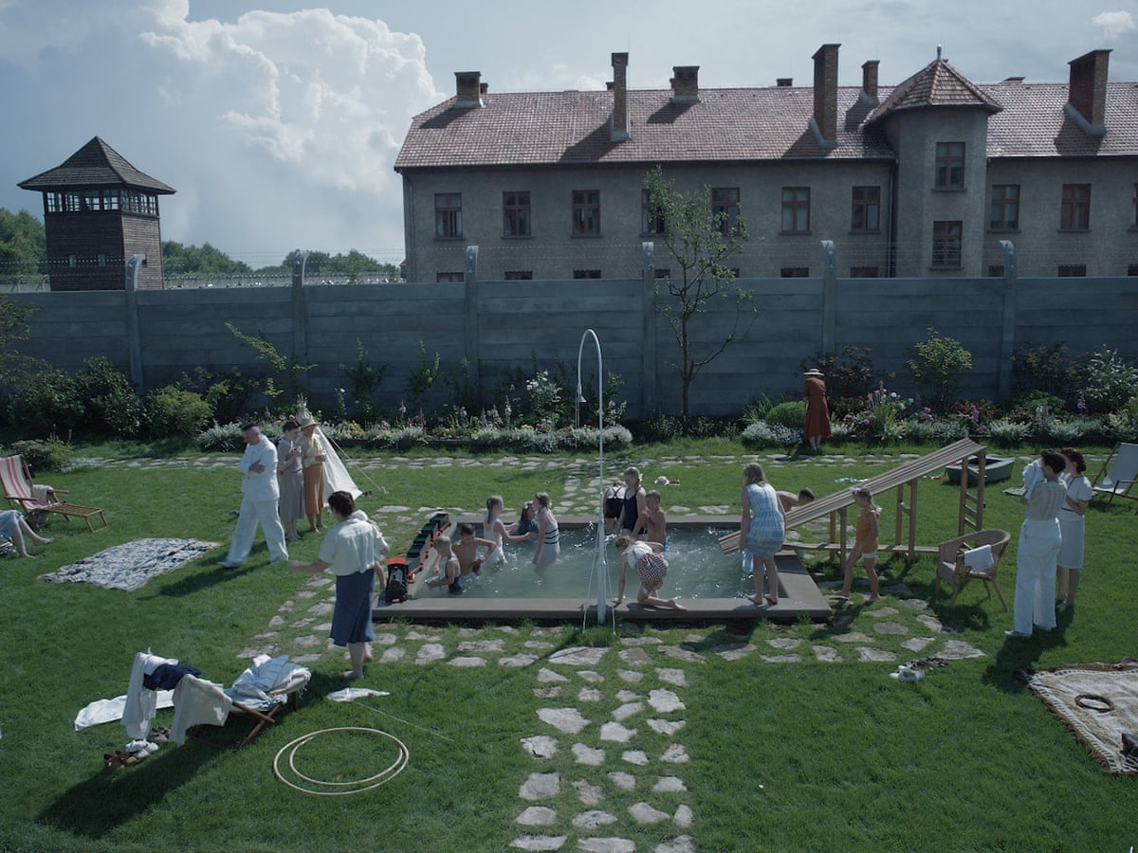

Slide 14
Cheer for God who wins

Slide 15
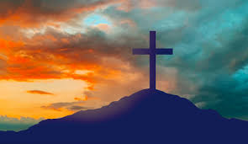
Cheer for God
...because at the cross he wins!

Slide 16
2. Cheer for the people who willingly
serve
God

Slide 17
Deborah
willing servant?

Slide 18
Deborah
willing servant?

Slide 19
Barak
willing servant?

Slide 20
Barak
willing servant?

Slide 21
Jael
willing servant?

Slide 22
Jael
willing servant?

Slide 23
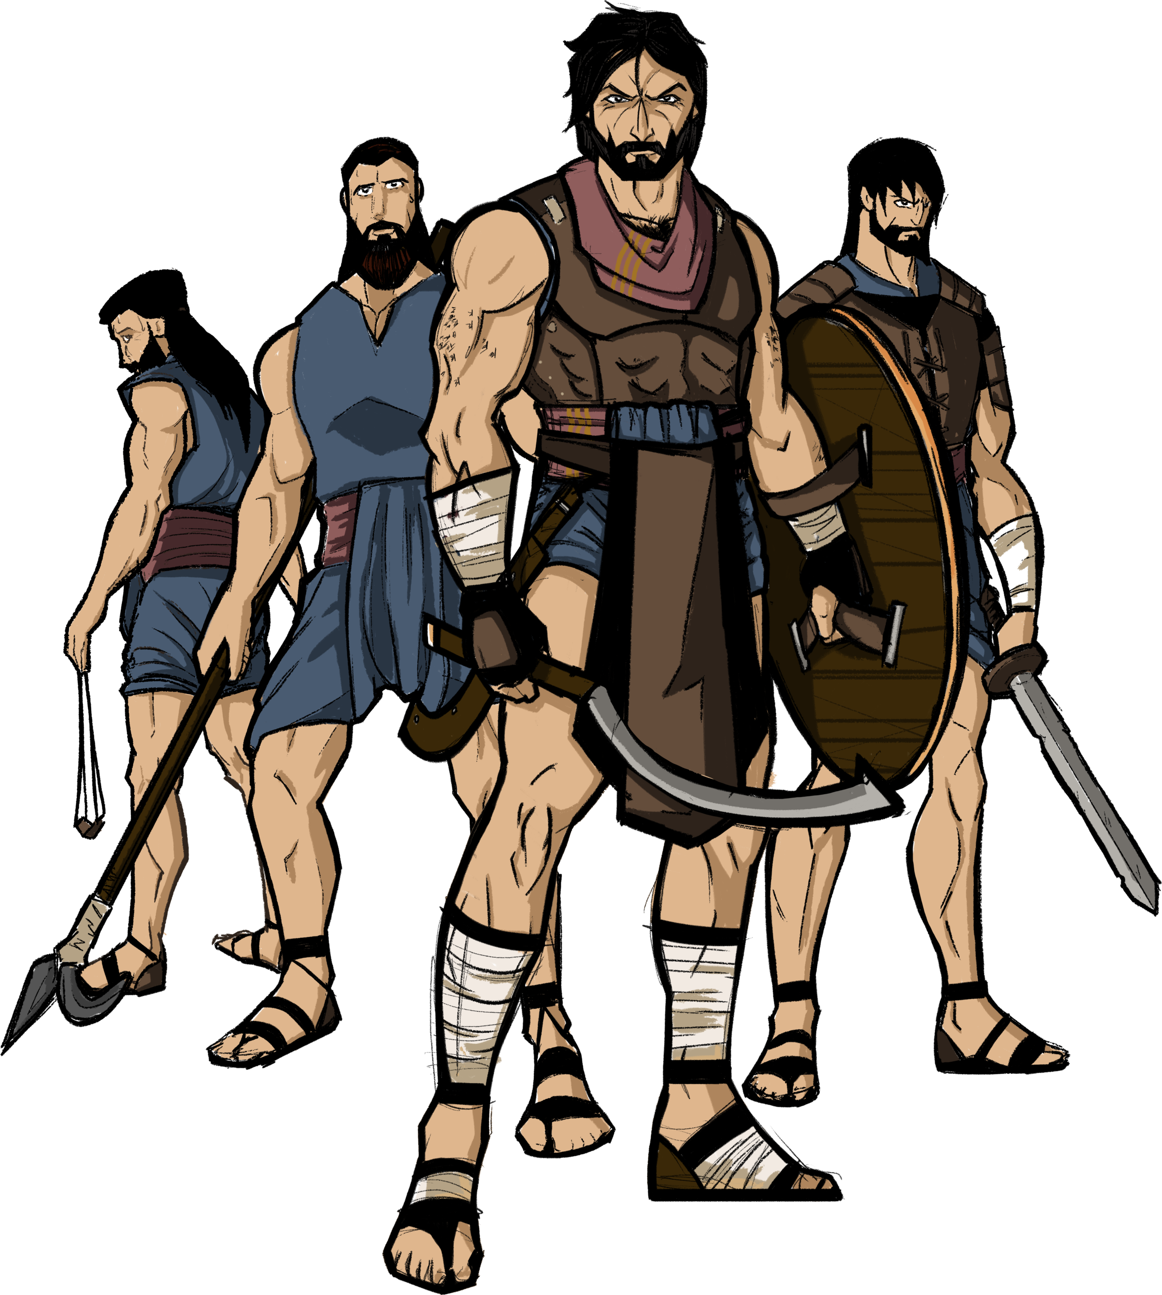
the tribes of Israel
willing servants?

Slide 24
the tribes of Israel
willing servants?

Slide 25
Cheer for Jesus
...who served God willingly

Slide 26
Philippians 2:6-11
who, being in very nature God, did not consider equality with God something to be used to his own advantage; 7 rather, he made himself nothing by taking the very nature of a servant, being made in human likeness. 8 And being found in appearance as a man, he humbled himself by becoming obedient to death – even death on a cross!

Slide 27
9 Therefore God exalted him to the highest place and gave him the name that is above every name, 10 that at the name of Jesus every knee should bow, in heaven and on earth and under the earth, 11 and every tongue acknowledge that Jesus Christ is Lord, to the glory of God the Father.

Slide 28
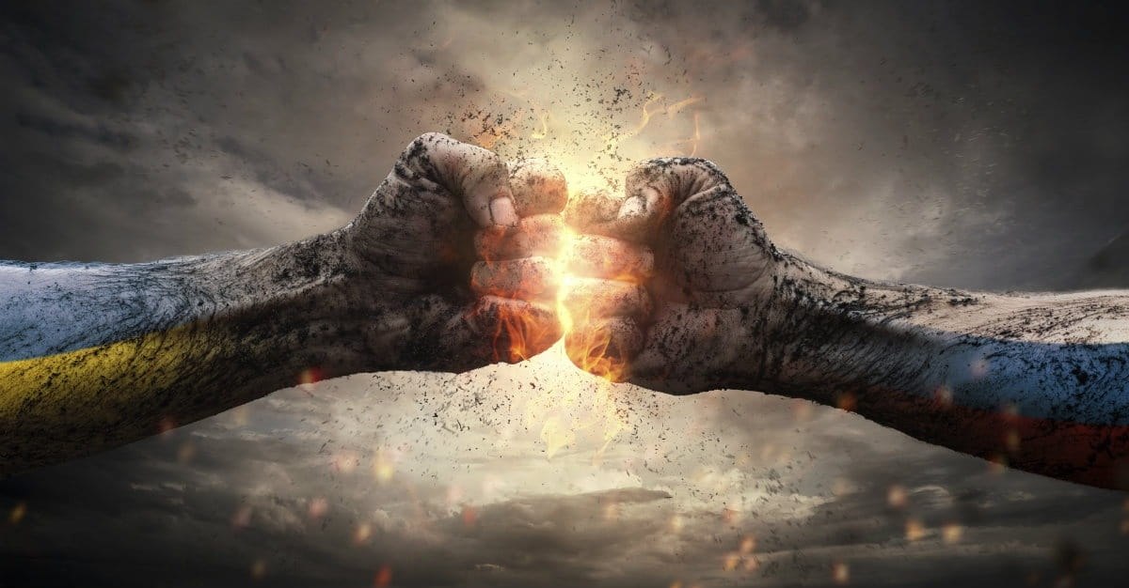
serve God willingly

