Slide 2
What Naomi...
Has
knows

Slide 3
What Naomi...
Has – a male relative
knows

Slide 4
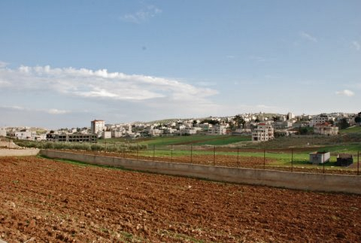

Slide 5
Leviticus 19
9 ‘When you reap the harvest of your land, do not reap to the very edges of your field or gather the gleanings of your harvest. 10 Do not go over your vineyard a second time or pick up the grapes that have fallen. Leave them for the poor and the foreigner.'

Slide 6
Deuteronomy 24
19 ‘When you are harvesting in your field and you overlook a sheaf, do not go back to get it. Leave it for the foreigner, the fatherless and the widow, so that the Lord your God may bless you in all the work of your hands.'

Slide 8
Boaz took notice of Ruth

Slide 9
Reasons for Boaz not to take notice of Ruth...
She's a stranger
She's young
She's poor
She's a migrant
She's not liked

Slide 10
Boaz took notice of Ruth

Slide 11
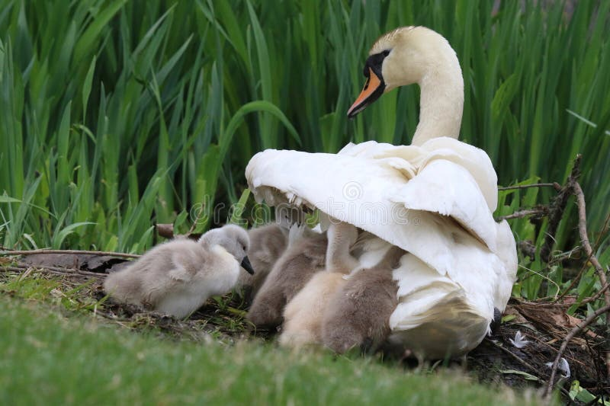
Boaz took notice of Ruth
...because Ruth had taken refuge in God.

Slide 12
Ruth 2
11 “I’ve been told all about what you have done for your mother-in-law since the death of your husband—how you left your father and mother and your homeland and came to live with a people you did not know before. 12 May the Lord repay you for what you have done. May you be richly rewarded by the Lord, the God of Israel, under whose wings you have come to take refuge.”

Slide 13
Reasons Boaz does take notice of Ruth...
She left
She came

Slide 14
Reasons Boaz does take notice of Ruth...
She left
She came
She refuged

Slide 15
Boaz took notice of Ruth
...because Ruth had taken refuge in God.

Slide 16
God has taken notice of Naomi and Ruth because they have taken refuge in him.

Slide 17
What Naomi...
Has – a male relative
Knows - Boaz is one of their guardian redeemers

Slide 18
God had taken notice of Naomi and Ruth because they had taken refuge in him.

Slide 19
Ephesians 2
6 And God raised us up with Christ and seated us with him in the heavenly realms in Christ Jesus, 7 in order that in the coming ages he might show the incomparable riches of his grace, expressed in his kindness to us in Christ Jesus.

